Slide 1
Selenium Webdriver
Workshop

Slide 2
Content
Automation Principles
Selenium WebDriver
Test Framework

Slide 3
Automation Principles

Slide 4
Why Test Automation
Supports execution of repeated test cases
Enables parallel execution
Encourages unattended execution
Improves accuracy thereby reducing human generated errors
Saves time and money
Reduce redundancy
High ROI
Faster GoTo market

Slide 5
Selenium Webdriver

Slide 6
Selenium
Selenium is a portable testing framework for web and mobile applications
Selenium
Web-based Automation Testing
Open Source
Multiple frameworks
Multiple program languages
Multiple browsers
Multiple OS

Slide 7
Selenium Webdriver
Selenium is a set of different software tools each with a different approach to supporting test automation.
Webdriver provides a programming interface for driving the browser for automation tests, using JSON Wire Protocol.
Selenium IDE
Selenium RC
Selenium WebDriver
Selenium GRID
History
Was first developed in 2004 by Jason Huggins as a JavaScript library that could interact with the page
In 2006 – Google engineers (Simon Stewart) start working on Selenium Webdriver
In 2011 – Release of WebDriver (Selenium 2)
In 2013 – Release of Webdriver2 (Selenium 3)

Slide 8
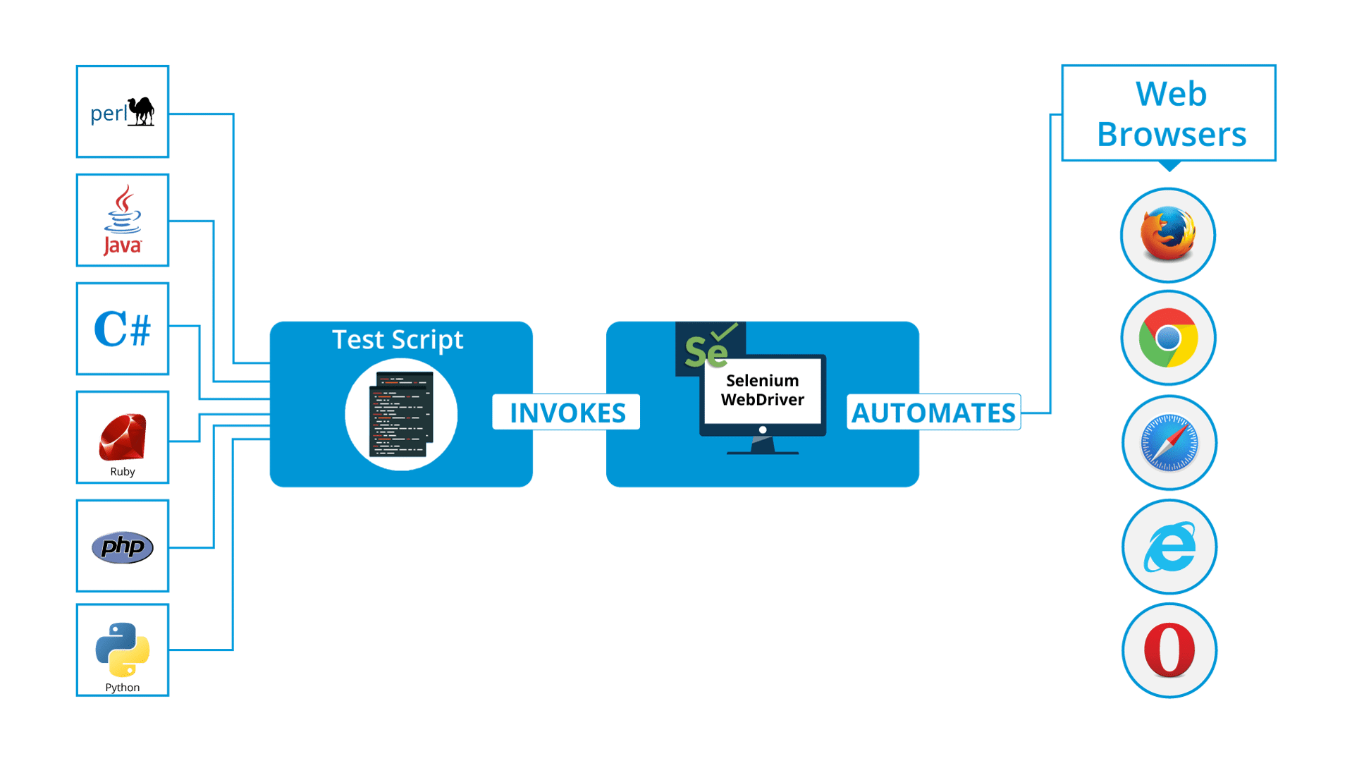
Selenium

Slide 9
Selenese
Actions
commands that generally
manipulates the state of the
application ( click this link,
select that option)
Accessors
examine the state of the
application and store the
results in a variable
(storeTitle)
Assertions
they verify that the state of
the application conforms to
what is expected
(verify, assert, waitFor)

Slide 10
Selenium Config
Install NuGet:
- Selenium.WebDriver
- Selenium.Support
- Selenium.Chrome.WebDriver
- Selenium.Firefox.WebDriver
- xUnit

Slide 11
xunit
Xunit
- is a free, open source, community-focused unit testing tool for the .NET Framework
- written by the original inventor of NUnit v2, xUnit.net is the latest technology for unit testing C#, F#, VB.NET and other .NET languages
Constructor and Dispose
- shared setup/cleanup code without sharing object instances
- IDisposable interface to your test class, and the cleanup code in the Dispose() method
Fact Attribute
- indicates a fact that needs to be run by the test runner
[Fact]
[Fact(DisplayName = "GIVEN the google homepage is open WHEN searching for new york times THEN results should appear")]

Slide 12
WebDriver – Invoking the browser
public class Tests : IDisposable
{
public IWebDriver driver;
public Tests() {
try{
driver = new ChromeDriver();
}
catch (Exception e) {
Console.WriteLine("exception" +e);
}
}

Slide 13
WebDriver – Navigate to URL
driver.Navigate().GoToUrl("https://www.fly-go.ro/");
driver.Manage().Window.Maximize();
driver.Navigate().Back();
driver.Navigate().Forward();
driver.Navigate().Refresh();
driver.Title();

Slide 14
WebDriver – Locating the elements
By ID
By Class Name
By Tag Name
By Name
By Link Text
By CSS
By Xpath
Using Javascript
IWebElementelement=driver.FindElement(By.Id(“ID"));
List<WebElement>cheeses=driver.findElements(By.className(“myClass"));
IWebElementframe=driver.FindElement(By.TagName("iframe"));
IWebElementcheese=driver.FindElement(By.Name(“name"));
IWebElementcheese=driver.FindElement(By.LinkText(“linktext"));
IWebElementcheese=driver.FindElement(By.CssSelector("#css"));
IList<IWebElement>labels=driver.FindElements(By.TagName("label"));
IList<IWebElement>inputs=(IList<IWebElement>)((IJavaScriptExecutor)driver).ExecuteScript("var labels = arguments[0], inputs = []; for (var i=0; i < labels.length; i++){"+"inputs.push(document.getElementById(labels[i].getAttribute('for'))); } return inputs;",labels);
IWebElementframe=driver.FindElement(By.XPath(“xpath"));

Slide 15
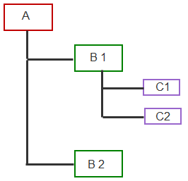
Xpath
Absolute
Relative
Axis | Description | Example from above figure
descendant | Children of the current node and their children too. | All the nodes are descendant of node A
ancestor | Parent of current node and their parent. | B1 and A are ancestor of C1.
following-sibling | following siblings | C2 is following sibling of C1 and B2 is following sibling of B1
preceding-sibling | preceding siblings | C1 is preceding sibling of C2 and B1 is preceding sibling of B2
following | following siblings and their descendants. | B2 is following for B1.
parent | parent of the current node. | B1 is parent of C1.
preceding | preceding siblings and their descendants. | B1, C1 and C2 are preceding to B2.
parent
children
siblings
ancestor
descendant

Slide 16
XPath
<div id="inputs" class="yui-skin-sam">
<input id="username" type="text" value="" placeholder="ID Yahoo" aria-required="true" tabindex="1" maxlength="96" name="login">
<input id="passwd" type="password" value="" placeholder="Parolă" aria-required="true" tabindex="2" maxlength="64" name="passwd">
<div id="captchaDiv"></div>
<div id="persistency">
<input id="persistent" type="hidden" value="" name=".persistent" style="background-color: rgb(255, 255, 255);">
<span id="pLabel" tabindex="3" for="persistent">
<span id="pLabelC" class="checkbox lg-sprite "> </span>
<span class="labeltxt">Păstrează-mă autentificat</span>
</span>
</div>
<div id="submit">
<button id=".save" class="lgbx-btn purple-bg" tabindex="4" name=".save" type="submit">Autentificare</button>
</div>
Element | XPATH | CSS
password field | //div[@id='inputs']/input[@id='passwd'] | css=div[id='inputs'] input[id='passwd'] css=div#inputs input#passwd
 | //div[@class='yui-skin-sam']/input[@id='passwd'] | css=.yui-skin-sam input#passwd
 | //div/input[contains(@placeholder,'Parolă')] | css=div input[placeholder=Parolă]
 | //div/input[@name="passwd"] | css=div input[name="passwd"]
 | //div/input[@name="passwd"][@id="passwd"] | css=div input[name="passwd"][id="passwd"]
 | //div/input[@name="login"]/following::input | css=div input[name="login"] ~ input
button | //div/button[contains(text(),'Autentificare')] | css=div button:contains('Autentificare')

Slide 17
Interacting with elements
//Enter text
driver.FindElement(By.Xpath(“xpath")).SendKeys(“myText");
//Click
driver.FindElement(By.Name(“name")).Click();
//Get text
driver.FindElement(By.XPath(“XPath")).Text
//Select
new SelectElement(driver.FindElement(By.Name(“name"))).SelectByText(“TextToSelect)");

Slide 18
Interacting with elements
// switch to window
driver.SwitchTo().Window("windowName");
//pop-up
Alert alert = driver.SwitchTo().Alert();
//drag and drop
IWebElement element = driver.FindElement(By.Name("source"));
IWebElement target = driver.FindElement(By.Name("target"));
(new Actions(driver)).DragAndDrop(element, target).Perform();

Slide 19
Explicit and implicit wait
Explicit
WebDriverWait wait = new WebDriverWait(driver, TimeSpan.FromSeconds(10));
wait.Until(ExpectedConditions.ElementToBeClickable(By.XPath(“XPath")));
Implicit
driver.Manage().Timeouts().ImplicitWait = TimeSpan.FromSeconds(10);

Slide 20
Test Framework

Slide 21
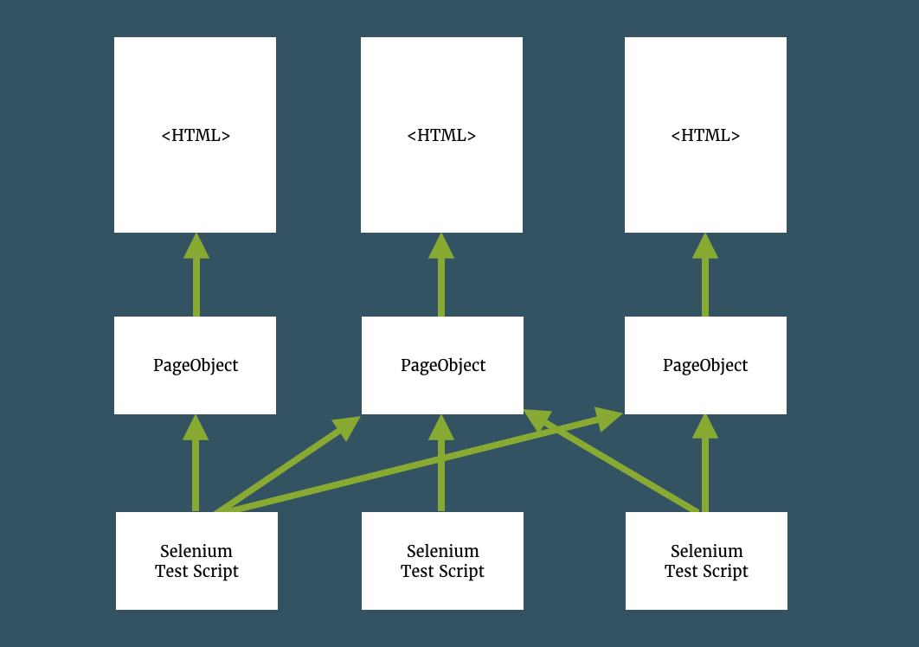
Page Object Pattern
A Page Object models the user interactions with the page as objects within the code.
This reduces the amount of duplicated code and means that if the UI changes, the fix need only be applied in one place.

Slide 22
https://www.mindmeister.com/334652100/mymindmap
https://www.w3schools.com/xml/xpath_intro.asp
https://medium.com/tech-tajawal/page-object-model-pom-design-pattern-f9588630800b
https://thefriendlytester.co.uk/2014/05/pageobject-pattern-why-how-and-more.html

Slide 23
AUTOMATION TESTING APPROACH

Slide 24
Scope
Automation Test Strategy is the overall document describing, planning and controlling all test automation activities in a project.
Goal of the document is description of an unambiguous test process, resulting in:
- Implementation of structures, processes and changes on which the quality is validated on pre-designed criteria
- describes key elements of automated testing that need to be considered,
- models for testing that can be used for designing a test automation architecture,
- considerations for successfully combining the elements to form an automated test environment.

Slide 25
Test process
Planning & Approach
Prepare Automation Test plan, including Test Strategy, Test Approach, Risk analysis, and Planning of a release.
Define/prepare the list of functionalities, components and test scenarios that will be automated.
Keep a list / traceability matrix with the main scenarios that are in scope for automation and were actually automated.
Preparation
Define automation backlog + test automation effort estimation. Plan board and define test effort.(* effort will be included in each sprint)
Readiness Test environment.
Prepare needed test data.
Update and analyze dependencies
Architecture and Design
Create Automation test framework
Design Test Automation tests
Update and maintain current existing tests (if the case).
Specification and Execution
Execute tests - this will be done in each sprint, after a new build is created.
Quick scan Automatic tests
Report and retest of defects
Document test results
Completion
Check if Definition of Done (DoD) is met.
Document System Test Report.
Close/No Close tasks.
Maintenance
Fix changes made in the functional flow
Tool adoption
Review defined automation tests.
Repair not running tests

Slide 26
Test Planning
What to automate
Repetitive tests that run for multiple builds
Tests that are highly subject to human error
Tests that require multiple data sets
Frequently-used functionality that introduces high risk conditions
Tests that take a lot of effort and time when doing manual testing
Prioritization
Sprint
Automation Backlog
risk/priority - what test should we keep, that tests can be throw away. -> probability of failure and the cost of failure
how expensive it is to do manually - which of the tests takes longest to be executed manually
how expensive it is to automate. - how much work it would be to write automation scripts for each scenario
Coverage
Functionality Matrix
Example based
Tool analysis based
Main component
Scenario
Risk/priority
How easy is to automate
How easy is to test it manually
Final Priority

Slide 27
Test Types / Objectives
Smoke Checks
Sanity/Functional Checks
Regression Checks
Component Checks
End-to-End Checks
UAT

Slide 28
Tool adoption
Needs and goals Analysis
Plan the POC
Define focus for POC
Tool adoption
- Data driven support
- Technology support
- Budget / Licensing
- Community support
Tool decision
- Learning curve
- User friendly / Ease of use
- Validation mechanism
- Reusability / Modularity
- CI support
- Basic scenario
- Medium scenario
- Complex scenario
- Time
- Results
- Scope
- Business context
- Business needs
- Business gain
- Tools
- Tools needs
- Characteristics mapping based on adoption results
- Tool for use

Slide 29
Environment
System Under Test
Test Platform
Test Browsers
Data Base
Continuous Integration
Test Tools & Configuration

Slide 30
Framework

Slide 31
Test Management
Test Process check and control procedures
Test Execution
Defect management
Risk management
Knowledge management

Slide 32
Test artifacts
Test plan
Test Strategy
Traceability matrix
Test case
Test script
Test data
Test results
Test reports

Slide 33

Let’s TEST!

